Slide 1



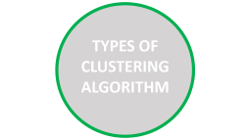



Self-Optimal Clustering Technique Using Optimized Threshold Function
BY PRAKHAR,ABHISHEK,RACHIT AND KUNAL

Slide 2
TYPES OF CLUSTERING ALGORITHM

Slide 3

TYPES OF CLUSTERING ALGORITHM
K-Means
Fuzzy c – Means
Expectation–maximization clustering(EM)
K-Mediods
In all these clustering Algorithms we need to specify the number of clusters
Goal: Automatically determine both the number of clusters and optimal cluster centers via a dynamic thresholding strategy.
Threshold function is optimized using Lagrange's form of interpolation polynomial.
Our Goal: Automatically determine both the number of clusters and optimal cluster centers.
Self‑Optimal Clustering (SOC):
SOC helps to find clusters by Threshold based clustering model

Slide 4




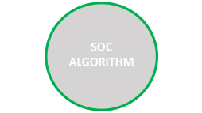

Self-Optimal Clustering Technique Using Optimized Threshold Function

Slide 5
SOC
ALGORITHM

Slide 6

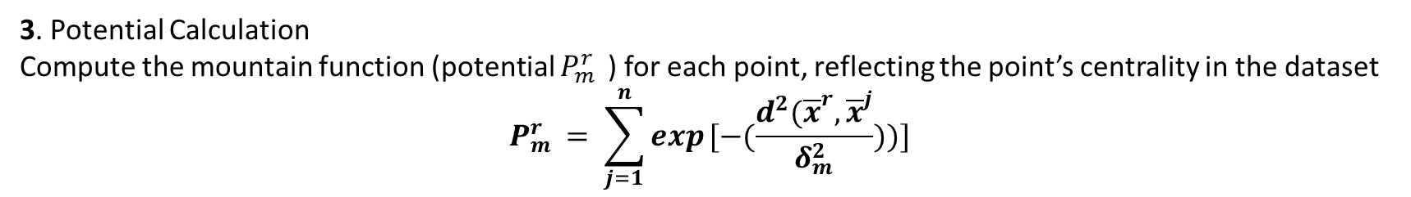
SOC ALGORITHM
1.Data Normalization
Normalize each data point $x^{j }$ ∀j=1,2,…,n in D-dimensional space to lie within a unit hypercube
$$\overline{x^{j}}= \frac{x^{j }−{(x)}_{min}}{{(x)}_{max}−{(x)}_{min}}$$
2. Initial Threshold Calculation
Compute a threshold $δ_{m}$ (neighborhood size) for the m-th cluster using a heuristic formula involving a scaling factor βm, initially set to 1
$$δ_{m}= \left(\frac{1}{2n}\sum_{j=1}^{n}{\frac{{min({x})}^{j}}{\sum_{i=1}^{D}{x_{i}^{j}}}} \right).(β_{m})$$
3. Potential Calculation
Compute the mountain function (potential $P_{m }^{r}$ ) for each point, reflecting the point’s centrality in the dataset
$$P_{m }^{r}= \sum_{j=1}^{n}{exp}[−(\frac{d^{2}({\overline{x}}^{r},{\overline{x}}^{j}}{δ_{m}^{2}}))]$$

Slide 7
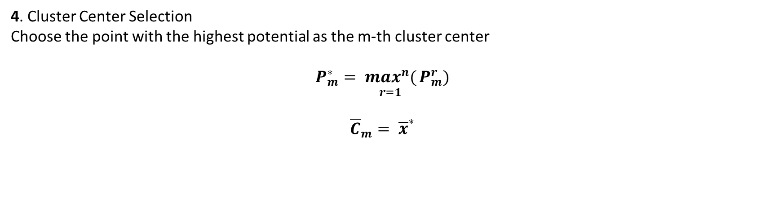
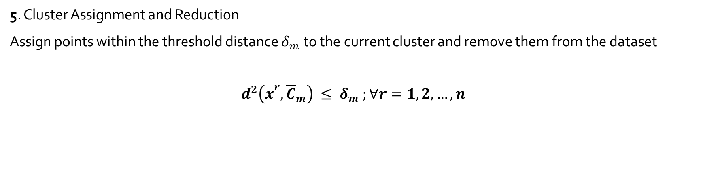
SOC ALGORITHM
4. Cluster Center Selection
Choose the point with the highest potential as the m-th cluster center
$$P_{m}^{∗}= {\underset{r=1}{\max^{n}(}{P}}_{m}^{r})$$
$${\overline{C}}_{m}= {\overline{x}}^{∗}$$
5. Cluster Assignment and Reduction
Assign points within the threshold distance $δ_{m}$to the current cluster and remove them from the dataset
$$d^{2}\left({\overline{x}}^{r}, {\overline{C}}_{m}\right) ≤ δ_{m} ;∀r=1,2,…,n$$
6. Repeat for All Clusters Repeat Steps 2–5 until M clusters are formed. Assign remaining points to the nearest cluster center.

Slide 8
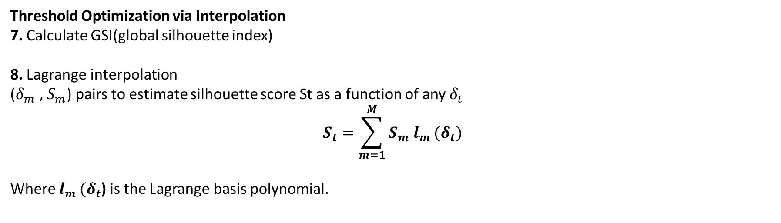
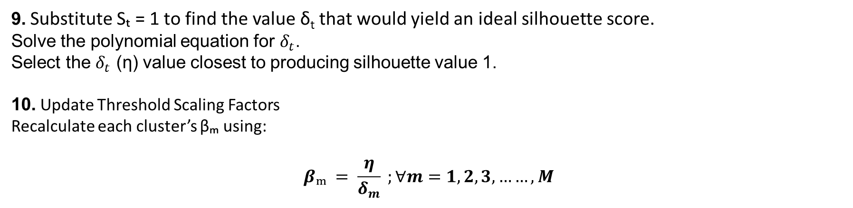
SOC ALGORITHM
Threshold Optimization via Interpolation
7. Calculate GSI(global silhouette index)
8. Lagrange interpolation
($δ_{m}$, $S_{m}$) pairs to estimate silhouette score St as a function of any $δ_{t}$
$$S_{t}=\sum_{m=1}^{M}{S_{m} l_{m }(δ_{t})}$$
Where $l_{m }(δ_{t}$) is the Lagrange basis polynomial.
9. Substitute Sₜ = 1 to find the value δ_{t} that would yield an ideal silhouette score.
Solve the polynomial equation for $δ_{t}$.
Select the $δ_{t}$ (η) value closest to producing silhouette value 1.
10. Update Threshold Scaling Factors
Recalculate each cluster’s βₘ using:
$$βₘ = \frac{η}{δ_{m}} ;∀m=1,2,3,……,M$$

Slide 9

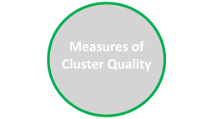




Self-Optimal Clustering Technique Using Optimized Threshold Function

Slide 10
Measures of Cluster Quality

Slide 11
Measure of Cluster Quality
For better quality of clustering, intercluster distances should be as high as possible, and intracluster distances among data points forming clusters should be as low as possible
Silhouette Index (SI)-
Measures how similar a point is to its own cluster vs. other clusters.
Ranges from -1 to 1.
Close to 1: Good clustering.
Around 0: Overlapping clusters.
Negative: Likely wrong clustering.
SOC showed higher average silhouette scores compared to K-means, FCM, EM, etc.

Slide 12
Measure of Cluster Quality
.2.Separation Index
Direct measure of how distinct the clusters are from each other.
Emphasizes inter-cluster distance.
Lower values again demonstrated SOC’s effectiveness.
3.Partition Index
Common in fuzzy clustering to evaluate fuzziness or clarity of cluster membership.
It is ratio of compactness and separation of clusters. Lower PI indicates better clustering.
SOC (even though not fuzzy) achieved well-defined partitions, reducing ambiguity in assignments.

Slide 13

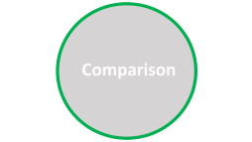
Self-Optimal Clustering Technique Using Optimized Threshold Function

Slide 14
Comparison

Slide 15
Comparison
For comparison we will use Algorithms like K-means, Fuzzy C-means (FCM), Expectation-Maximization (EM)K-medoids, Improved Mountain Clustering (IMC) using evaluation tools like Silhouette Score, Dunn Index, Cluster Quality etc.
Some Findings –
SOC achieved higher average silhouette coefficients than all baseline methods. Dunn Index and separation scores were consistently better which means clusters were compact and well-separated.
Algorithm | Requires k? (k=no. of cluster) | Silhouette Score | Dunn Index | Auto Threshold | Cluster Quality
K-means | Yes | Medium | Low | - | Medium
FCM | Yes | Medium | Medium | - | Medium
K-medoids | Yes | Medium | Low | - | Medium
IMC | Yes | High | Medium | Yes | High
SOC(proposed) | Yes | Highest | Highest | Yes | Very High

Slide 16


Self-Optimal Clustering Technique Using Optimized Threshold Function

Slide 17
STRENGTHS
AND
LIMITATIONS

Slide 18
STRENGTHS AND LIMITATIONS
STRENGTHS: 1. Improved Cluster Quality and automation 2.Well-Supported by Validity Indices(like Silhouette) 3. Enhanced Visualization(The resulting clusters are often more visually distinct and easier to interpret)
LIMITATIONS:
1.Time-consuming, especially with large datasets
because SOC involves density estimation and
peak detection.
2. Sensitive to threshold-interpolation.

Slide 19


Self-Optimal Clustering Technique Using Optimized Threshold Function

Slide 20
Enhancement
Application

Slide 21
Enhancement
PSO‑enhanced SOC: Introduces Particle Swarm Optimization for better
threshold tuning and centroid selection although offers performance gains at higher cost.
Application
Threshold-based clustering in Wireless Sensor Networks( WSNs): Similar threshold optimization techniques used in sensor networks to select cluster heads.
Widely used in medical imaging.

Slide 22

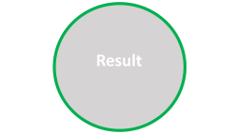
Self-Optimal Clustering Technique Using Optimized Threshold Function

Slide 23
Result

Slide 24


Original image
Clustered image

Slide 25
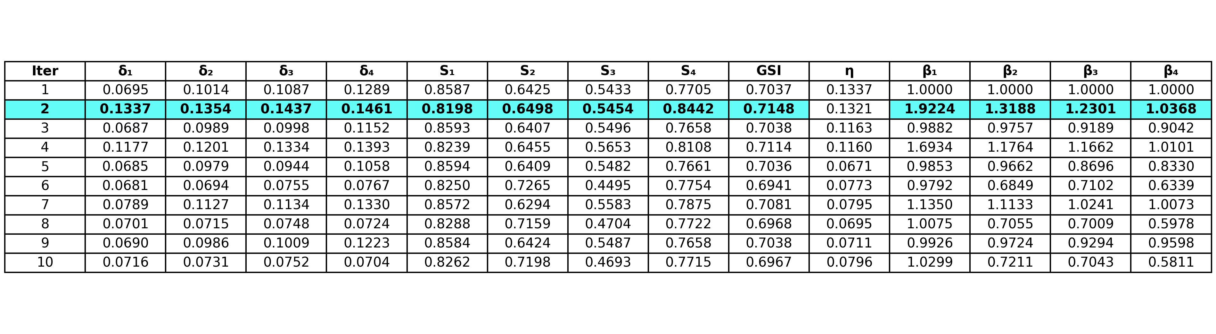
Parameters over various iterations

Slide 26
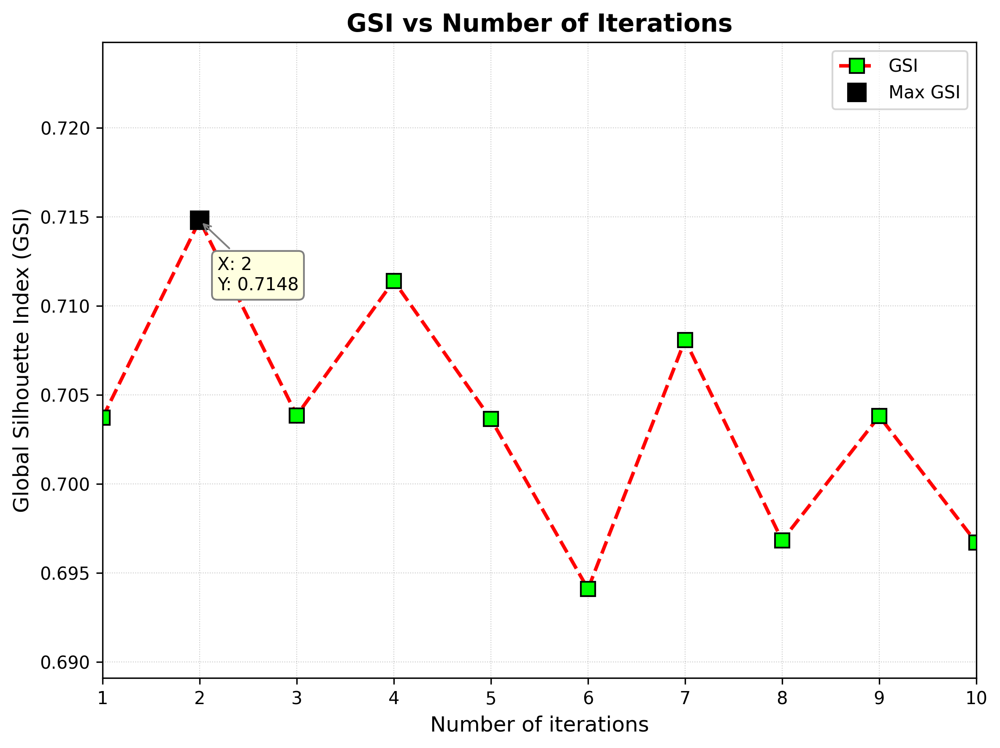

Slide 27


Self-Optimal Clustering Technique Using Optimized Threshold Function

Slide 28
Summary

Slide 29
Summary
1.SOC is parameter free, density-based clustering algorithm that intelligently determines both the number of clusters and the optimal threshold for cluster formation.
2.Produces high-quality, well-separated clusters across a variety of test scenarios.
3.SOC applications are in Pattern recognition, data mining, bioinformatics and sensor networks etc.
4. Its performance, validated through both statistical and visual tools, positions it as a strong alternative to conventional clustering methods, especially in scenarios where prior knowledge of data structure is unavailable.

Slide 30
THANK YOU

